Slide 1
FMCW Lidar Experiments

Slide 2
More Stuff Needed
Spectrum Analyzer
Notes:
S_i(f) = \frac{{i_0}^2}{2}\left[ \frac{{\tau}_c/(2\pi)}{1+\left(\pi f {\tau}_c \right)^2} \left\{ 1- e^{-\frac{2\tau}{{\tau}_c}} \left[ \cos(2\pi f\tau) + \frac{1}{\pi f \tau_c} \sin(2\pi f \tau) \right] \right\} \right]
\tau_c = \frac{2}{\textrm{linewidth}},\quad i_0: \textrm{nominal photocurrent amplitude},\quad \tau: \textrm{path delay}

Slide 3
More Stuff Needed
For free space
Beam profiler
Optics for NF/FF monitoring
IR camera
Galvo mirror?
Notes:
S_i(f) = \frac{{i_0}^2}{2}\left[ \frac{{\tau}_c/(2\pi)}{1+\left(\pi f {\tau}_c \right)^2} \left\{ 1- e^{-\frac{2\tau}{{\tau}_c}} \left[ \cos(2\pi f\tau) + \frac{1}{\pi f \tau_c} \sin(2\pi f \tau) \right] \right\} \right]
\tau_c = \frac{2}{\textrm{linewidth}},\quad i_0: \textrm{nominal photocurrent amplitude},\quad \tau: \textrm{path delay}

Slide 4
GPIB Setup
Keithley 2400
OSA
Waveform generator
Power supply
Notes:
S_i(f) = \frac{{i_0}^2}{2}\left[ \frac{{\tau}_c/(2\pi)}{1+\left(\pi f {\tau}_c \right)^2} \left\{ 1- e^{-\frac{2\tau}{{\tau}_c}} \left[ \cos(2\pi f\tau) + \frac{1}{\pi f \tau_c} \sin(2\pi f \tau) \right] \right\} \right]
\tau_c = \frac{2}{\textrm{linewidth}},\quad i_0: \textrm{nominal photocurrent amplitude},\quad \tau: \textrm{path delay}

Slide 5
Laser Characterization
DC measurements
Driving current vs. wavelength, voltage, linewidth (FWMH), output power
AC measurements
Driving bandwidth using OSA
Phase noise characterization
Heterodyne measurement
Long fiber
Optical modulator
Mix with another laser
Notes:
S_i(f) = \frac{{i_0}^2}{2}\left[ \frac{{\tau}_c/(2\pi)}{1+\left(\pi f {\tau}_c \right)^2} \left\{ 1- e^{-\frac{2\tau}{{\tau}_c}} \left[ \cos(2\pi f\tau) + \frac{1}{\pi f \tau_c} \sin(2\pi f \tau) \right] \right\} \right]
\tau_c = \frac{2}{\textrm{linewidth}},\quad i_0: \textrm{nominal photocurrent amplitude},\quad \tau: \textrm{path delay}

Slide 6
Triangular Modulation Setup: Open Loop
Waveform generator
RF port balun
Notes:
S_i(f) = \frac{{i_0}^2}{2}\left[ \frac{{\tau}_c/(2\pi)}{1+\left(\pi f {\tau}_c \right)^2} \left\{ 1- e^{-\frac{2\tau}{{\tau}_c}} \left[ \cos(2\pi f\tau) + \frac{1}{\pi f \tau_c} \sin(2\pi f \tau) \right] \right\} \right]
\tau_c = \frac{2}{\textrm{linewidth}},\quad i_0: \textrm{nominal photocurrent amplitude},\quad \tau: \textrm{path delay}

Slide 7
Triangular Modulation Setup: Open Loop
Characterization
Linearity using spectrogram
Feasibility of closed-loop PLL
Characterize noise sources
Laser linewidth testing
Notes:
S_i(f) = \frac{{i_0}^2}{2}\left[ \frac{{\tau}_c/(2\pi)}{1+\left(\pi f {\tau}_c \right)^2} \left\{ 1- e^{-\frac{2\tau}{{\tau}_c}} \left[ \cos(2\pi f\tau) + \frac{1}{\pi f \tau_c} \sin(2\pi f \tau) \right] \right\} \right]
\tau_c = \frac{2}{\textrm{linewidth}},\quad i_0: \textrm{nominal photocurrent amplitude},\quad \tau: \textrm{path delay}

Slide 8
Triangular Modulation Setup: Closed Loop
Laser
90:10 splitter
MZI setup: splitter, delay line, combiner
Balanced PD
Electronics: Phase detector, loop filter, integrator, laser buffer
+ optical amplifier for amplitude equalization
Notes:
S_i(f) = \frac{{i_0}^2}{2}\left[ \frac{{\tau}_c/(2\pi)}{1+\left(\pi f {\tau}_c \right)^2} \left\{ 1- e^{-\frac{2\tau}{{\tau}_c}} \left[ \cos(2\pi f\tau) + \frac{1}{\pi f \tau_c} \sin(2\pi f \tau) \right] \right\} \right]
\tau_c = \frac{2}{\textrm{linewidth}},\quad i_0: \textrm{nominal photocurrent amplitude},\quad \tau: \textrm{path delay}

Slide 9
Triangular Modulation Setup: Closed Loop
Laser
90:10 splitter
MZI setup: splitter, delay line, combiner
Balanced PD
Electronics: Phase detector, loop filter, integrator, laser buffer
Or, mixer + integrator + oscillator
+ optical amplifier for amplitude equalization
Notes:
S_i(f) = \frac{{i_0}^2}{2}\left[ \frac{{\tau}_c/(2\pi)}{1+\left(\pi f {\tau}_c \right)^2} \left\{ 1- e^{-\frac{2\tau}{{\tau}_c}} \left[ \cos(2\pi f\tau) + \frac{1}{\pi f \tau_c} \sin(2\pi f \tau) \right] \right\} \right]
\tau_c = \frac{2}{\textrm{linewidth}},\quad i_0: \textrm{nominal photocurrent amplitude},\quad \tau: \textrm{path delay}

Slide 10
Chirping Linearity Measurement
Laser
Splitter
Additional delay line
Combiner
Balanced PD
Scope
PC?
Notes:
S_i(f) = \frac{{i_0}^2}{2}\left[ \frac{{\tau}_c/(2\pi)}{1+\left(\pi f {\tau}_c \right)^2} \left\{ 1- e^{-\frac{2\tau}{{\tau}_c}} \left[ \cos(2\pi f\tau) + \frac{1}{\pi f \tau_c} \sin(2\pi f \tau) \right] \right\} \right]
\tau_c = \frac{2}{\textrm{linewidth}},\quad i_0: \textrm{nominal photocurrent amplitude},\quad \tau: \textrm{path delay}

Slide 11
Phase Noise Measurement
Laser
MZI: 2 50:50 Coupler + very long delay line
Balanced PD
Optical modulator
Spectrum analyzer? Scope?
Notes:
S_i(f) = \frac{{i_0}^2}{2}\left[ \frac{{\tau}_c/(2\pi)}{1+\left(\pi f {\tau}_c \right)^2} \left\{ 1- e^{-\frac{2\tau}{{\tau}_c}} \left[ \cos(2\pi f\tau) + \frac{1}{\pi f \tau_c} \sin(2\pi f \tau) \right] \right\} \right]
\tau_c = \frac{2}{\textrm{linewidth}},\quad i_0: \textrm{nominal photocurrent amplitude},\quad \tau: \textrm{path delay}

Slide 12
Free Space Setup
Chirped laser (OL/CL)
Splitter
Circulator
Lens+reflector
Additional delay line
Combiner
Photodetector
Scope
Notes:
S_i(f) = \frac{{i_0}^2}{2}\left[ \frac{{\tau}_c/(2\pi)}{1+\left(\pi f {\tau}_c \right)^2} \left\{ 1- e^{-\frac{2\tau}{{\tau}_c}} \left[ \cos(2\pi f\tau) + \frac{1}{\pi f \tau_c} \sin(2\pi f \tau) \right] \right\} \right]
\tau_c = \frac{2}{\textrm{linewidth}},\quad i_0: \textrm{nominal photocurrent amplitude},\quad \tau: \textrm{path delay}

Slide 13
Phased Array Testing
Fourier space imaging
Real space imaging
Notes:
S_i(f) = \frac{{i_0}^2}{2}\left[ \frac{{\tau}_c/(2\pi)}{1+\left(\pi f {\tau}_c \right)^2} \left\{ 1- e^{-\frac{2\tau}{{\tau}_c}} \left[ \cos(2\pi f\tau) + \frac{1}{\pi f \tau_c} \sin(2\pi f \tau) \right] \right\} \right]
\tau_c = \frac{2}{\textrm{linewidth}},\quad i_0: \textrm{nominal photocurrent amplitude},\quad \tau: \textrm{path delay}

Slide 14
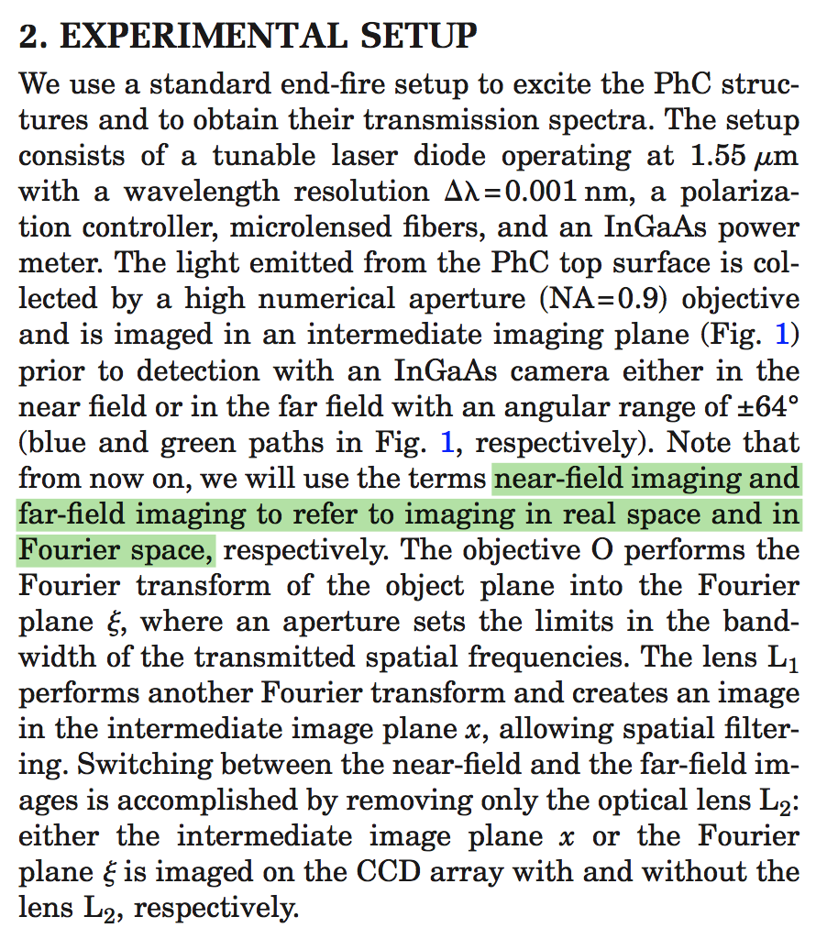
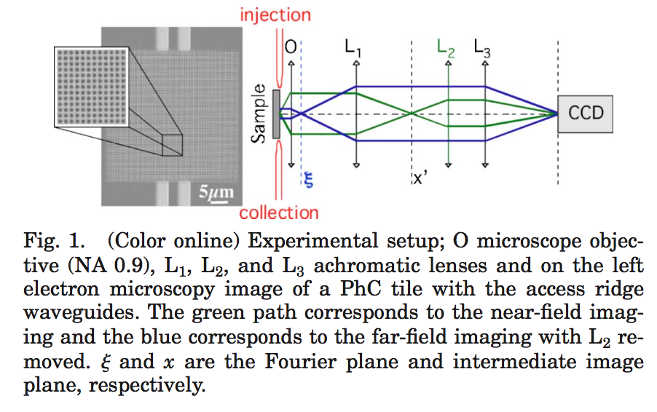
Notes:
S_i(f) = \frac{{i_0}^2}{2}\left[ \frac{{\tau}_c/(2\pi)}{1+\left(\pi f {\tau}_c \right)^2} \left\{ 1- e^{-\frac{2\tau}{{\tau}_c}} \left[ \cos(2\pi f\tau) + \frac{1}{\pi f \tau_c} \sin(2\pi f \tau) \right] \right\} \right]
\tau_c = \frac{2}{\textrm{linewidth}},\quad i_0: \textrm{nominal photocurrent amplitude},\quad \tau: \textrm{path delay}

Slide 15
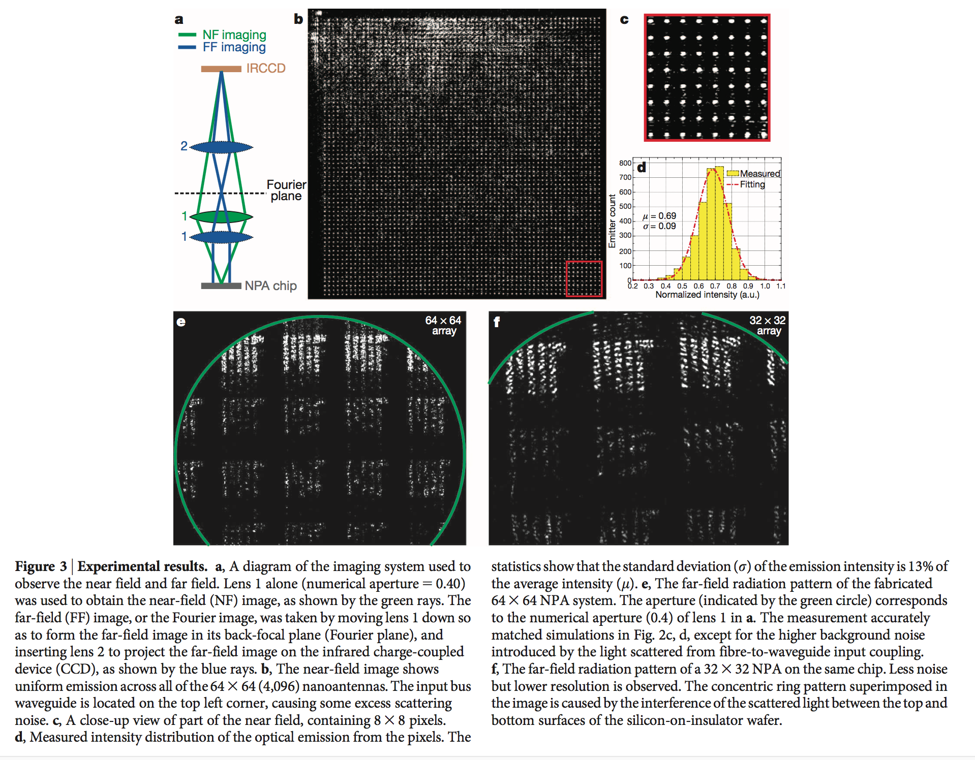
Notes:
S_i(f) = \frac{{i_0}^2}{2}\left[ \frac{{\tau}_c/(2\pi)}{1+\left(\pi f {\tau}_c \right)^2} \left\{ 1- e^{-\frac{2\tau}{{\tau}_c}} \left[ \cos(2\pi f\tau) + \frac{1}{\pi f \tau_c} \sin(2\pi f \tau) \right] \right\} \right]
\tau_c = \frac{2}{\textrm{linewidth}},\quad i_0: \textrm{nominal photocurrent amplitude},\quad \tau: \textrm{path delay}

Slide 16
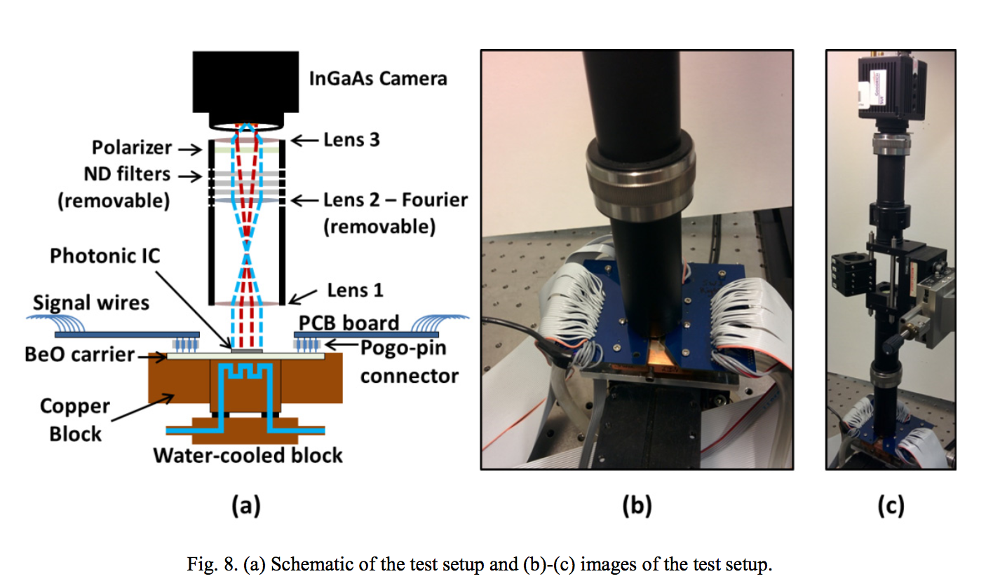
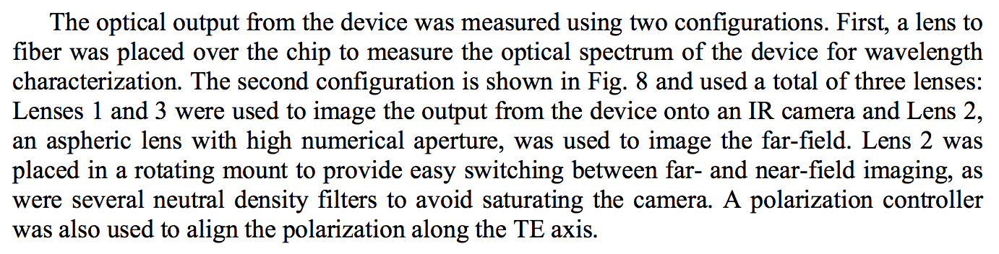
Notes:
S_i(f) = \frac{{i_0}^2}{2}\left[ \frac{{\tau}_c/(2\pi)}{1+\left(\pi f {\tau}_c \right)^2} \left\{ 1- e^{-\frac{2\tau}{{\tau}_c}} \left[ \cos(2\pi f\tau) + \frac{1}{\pi f \tau_c} \sin(2\pi f \tau) \right] \right\} \right]
\tau_c = \frac{2}{\textrm{linewidth}},\quad i_0: \textrm{nominal photocurrent amplitude},\quad \tau: \textrm{path delay}

Slide 17
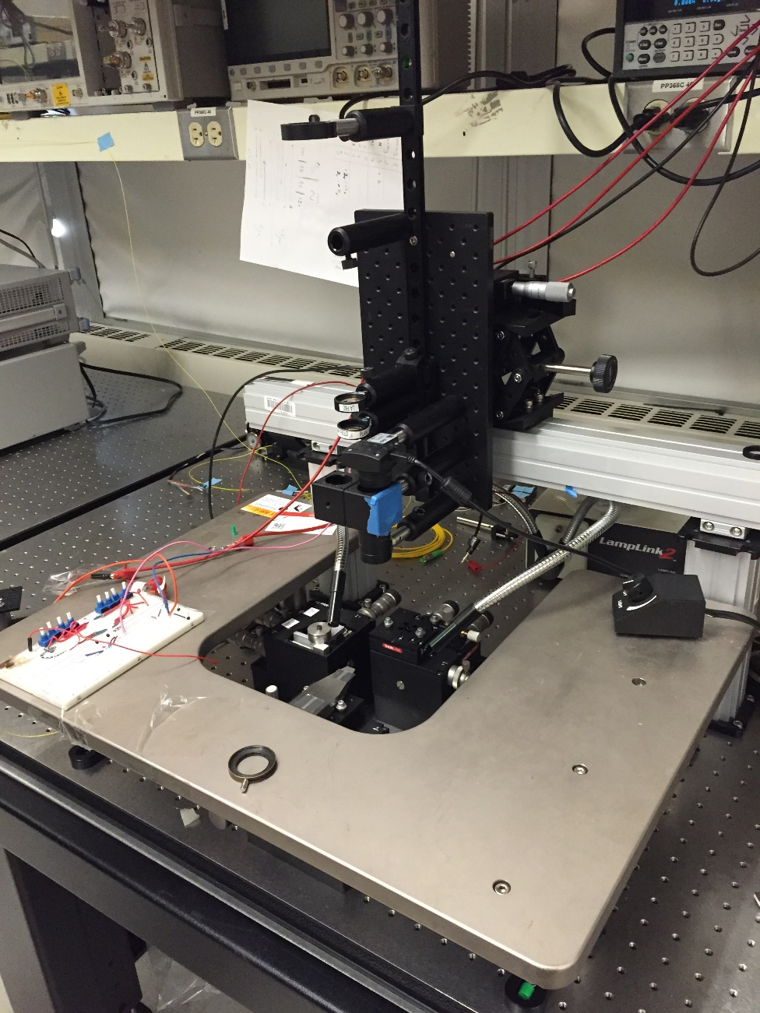
Near-field lens: LA-F60
Far-field lens: PLANO F100
Visible light camera: IDS UI-1480LE-C-HQ
Visible-IR isolation:
Silver mirror: Thorlabs CMIPO1
Dicromatic mirror: Thorlabs FFM1
Post holders/Posts (for holding lenses): Thorlabs
Bridge: Thorlabs
IR camera: GOODRICH SUI
Notes:
S_i(f) = \frac{{i_0}^2}{2}\left[ \frac{{\tau}_c/(2\pi)}{1+\left(\pi f {\tau}_c \right)^2} \left\{ 1- e^{-\frac{2\tau}{{\tau}_c}} \left[ \cos(2\pi f\tau) + \frac{1}{\pi f \tau_c} \sin(2\pi f \tau) \right] \right\} \right]
\tau_c = \frac{2}{\textrm{linewidth}},\quad i_0: \textrm{nominal photocurrent amplitude},\quad \tau: \textrm{path delay}

Slide 18
Imaging setup
Existing near field lens setup
3200mm/500mm
F=200mm
NA=0.28

Slide 19
Range Detection Setup Equipment
Tunable laser: Agilent
Laser diode controller: Thorlabs ITC-4001
EDFA: Amonics AEDFA-PA-35
Waveform generator: Agilent 335-22A
Laser diode: JDS Uniphase 1KHz DFB 40mW
Laser diode holder: Thorlabs
Polarization controller
Lens: Correct Japan 0.25NA 10x, 20x
Lens holder: Nanomax APY002
Beam Profiler

Slide 20
Range Detection Setup Equipment
Reflectors
Retro-reflector
Diffuser: Thorlabs (next step - used by most LIDAR literatures)
Movable rail: Aerotec pro 225 (Doppler)
ND filter: New focus 5214
IR cards: Thorlabs 1500 detector card (VRC4)
Microscope: CascadeMicrotech CMPS-888
8-pin probe holder: CascadeMicrotech
Probes
9-pin probes: CascadeMicrotech dcq-09
5-pin: CascadeMicrotech GSGSG-100

Slide 21
Lens F60mm, Qty:1
http://www.thorlabs.com/thorproduct.cfm?partnumber=AC254-060-Cf=60.0 mm, Ø1" Achromatic Doublet, ARC: 1050-1620 nm
Lens F100mm, Qty:1
http://www.thorlabs.com/thorproduct.cfm?partnumber=AC254-100-Cf=100.0 mm, Ø1" Achromatic Doublet, ARC: 1050-1620 nm
Column Rail, Qty:1
http://www.thorlabs.com/thorproduct.cfm?partnumber=RLA2400Dovetail Optical Rail, 24", Imperial
Rail Carriers, Qty:3
http://www.thorlabs.com/thorproduct.cfm?partnumber=RC1
Dovetail Rail Carrier, 1.00" x 1.00" (25.4 mm x 25.4 mm
Lens Mount, Qty:3
http://www.thorlabs.com/thorproduct.cfm?partnumber=LMR1Imperial Lens Mount For 1" Optics, 8-32 Tap
Lens Post, Qty:3
http://www.thorlabs.com/thorproduct.cfm?partnumber=TR3Ø1/2" Optical Post, SS, 8-32 Setscrew, 1/4"-20 Tap, L = 3"
Post Holder:
http://www.thorlabs.com/thorproduct.cfm?partnumber=PH3Ø1/2" Post Holder, Spring-Loaded Hex-Locking Thumbscrew, L = 3"
Fiber Holder for horizontal coupling (This is also for Chen, so you guys can determine how many you want)
http://www.thorlabs.us/thorproduct.cfm?partnumber=HFV002Tapered V-Groove Fiber Holder for Multi-Axis Stages
Notes:
S_i(f) = \frac{{i_0}^2}{2}\left[ \frac{{\tau}_c/(2\pi)}{1+\left(\pi f {\tau}_c \right)^2} \left\{ 1- e^{-\frac{2\tau}{{\tau}_c}} \left[ \cos(2\pi f\tau) + \frac{1}{\pi f \tau_c} \sin(2\pi f \tau) \right] \right\} \right]
\tau_c = \frac{2}{\textrm{linewidth}},\quad i_0: \textrm{nominal photocurrent amplitude},\quad \tau: \textrm{path delay}

Slide 22
TODO
Laser coherence measurement
Interferometric PD current measurement for both swept/non-swept case
Non-swept can be confusing as it might not be easy to distinguish from sweep nonlinearity
Mix with independent laser to measure the linewidth directly
Open loop sweep linearity measurement
Spectrograph measurement
Benchtop OPLL implementation
Notes:
S_i(f) = \frac{{i_0}^2}{2}\left[ \frac{{\tau}_c/(2\pi)}{1+\left(\pi f {\tau}_c \right)^2} \left\{ 1- e^{-\frac{2\tau}{{\tau}_c}} \left[ \cos(2\pi f\tau) + \frac{1}{\pi f \tau_c} \sin(2\pi f \tau) \right] \right\} \right]
\tau_c = \frac{2}{\textrm{linewidth}},\quad i_0: \textrm{nominal photocurrent amplitude},\quad \tau: \textrm{path delay}

Slide 23
PLL + FF cancellation components
2x mini circuits phase detector (ZRPD-1+)
Phase modulator from thorlabs (LN53S-FC)
Integrator (one for the PLL, one for the FF)
Loop filter
Notes:
S_i(f) = \frac{{i_0}^2}{2}\left[ \frac{{\tau}_c/(2\pi)}{1+\left(\pi f {\tau}_c \right)^2} \left\{ 1- e^{-\frac{2\tau}{{\tau}_c}} \left[ \cos(2\pi f\tau) + \frac{1}{\pi f \tau_c} \sin(2\pi f \tau) \right] \right\} \right]
\tau_c = \frac{2}{\textrm{linewidth}},\quad i_0: \textrm{nominal photocurrent amplitude},\quad \tau: \textrm{path delay}

Slide 24
PLL + FF cancellation components
Mini circuits PD
500Ohms load required
Notes:
S_i(f) = \frac{{i_0}^2}{2}\left[ \frac{{\tau}_c/(2\pi)}{1+\left(\pi f {\tau}_c \right)^2} \left\{ 1- e^{-\frac{2\tau}{{\tau}_c}} \left[ \cos(2\pi f\tau) + \frac{1}{\pi f \tau_c} \sin(2\pi f \tau) \right] \right\} \right]
\tau_c = \frac{2}{\textrm{linewidth}},\quad i_0: \textrm{nominal photocurrent amplitude},\quad \tau: \textrm{path delay}

Slide 25
Benchtop PLL
Phase detector

Slide 26
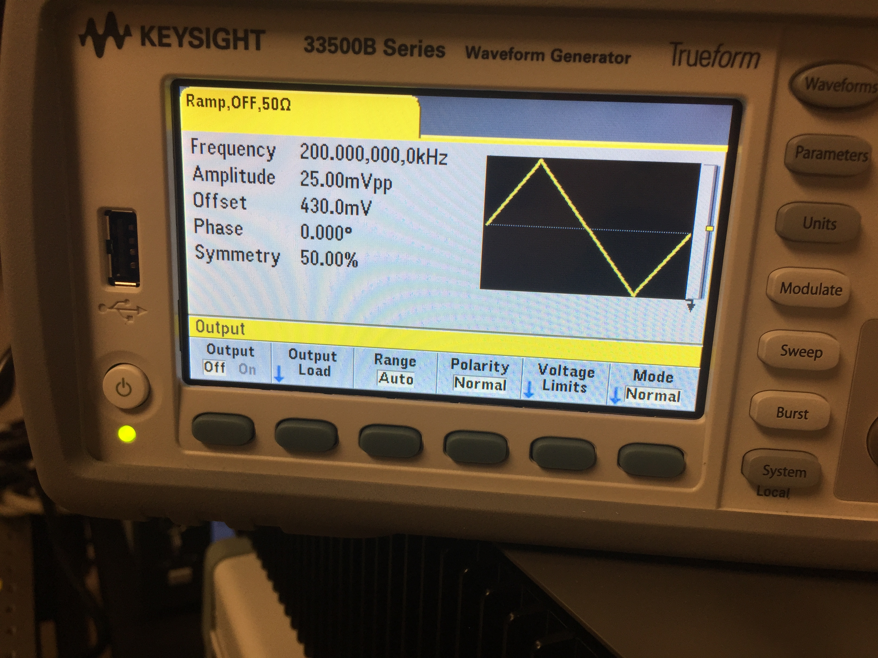
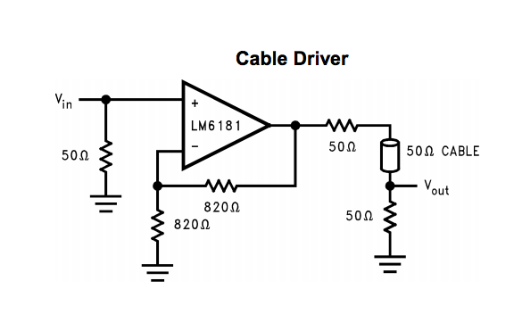
Integrator
405mV → 455mV on 50ohm load
8.1mA → 9.1mA in 2.5us

Slide 27
Integrator
405mV → 455mV in 2.5us
20000V/s
47nF

Slide 28
IR cam
Tube lens
FF lens
Visible cam
Tube lens
dichroic
objective
chip

Slide 29
DAQ
Computer
Analog out
Waveform
gen
mixer
Integrator
BPD
Laser driver
AMZI
Laser

Slide 30
FPGA Implementation
Clk
OSC
PD
ADC
FPGA
TIA
DAC
EPHI
CHIP
Laser
BUF/ BIAS

